Slide 1

Student Management System
CSC102 Object Oriented Programming
“Make It Digital”
Team
Roll No. Name Programme
AU1841130 Harsh Mange BTECH ICT
AU1841140 Preyanshu Sukhadia BTECH ICT

Slide 2
Problem Definition
Pen and paper based mechanisms to store the details of student are less reliable and there’s high risk of loss of the data.
Partial paper checking is often among the complaints of various students.
Leakage of test papers is very frequent when the tests are sanctioned for different sections at different time for the same course.

Slide 3
Objective and End Users
Objective of the project
To automate and digitalize the functions of managing student attendance, marks calculation, quiz and faculty management.
Software End Users
Admin, student and faculty.

Slide 4
Key functionality/features
Add, update and delete student : admin
Add, update and delete faculty : admin
Take attendance : faculty
Create quiz : faculty
Select and add courses : student
View attendance : student
Attempt quiz : student
View result : student

Slide 5
System Flow/Logic/Flowchart of the Project
The software will be used in a collage. The different users who will use the system are admin, student and faculty.
Admin manages faculty/student like add faculty/student, update information and delete information.
Faculty can create and take quiz and manage attendance.
Student can see his/her attendance, marksheet, attempt the quiz and select course.

Slide 6
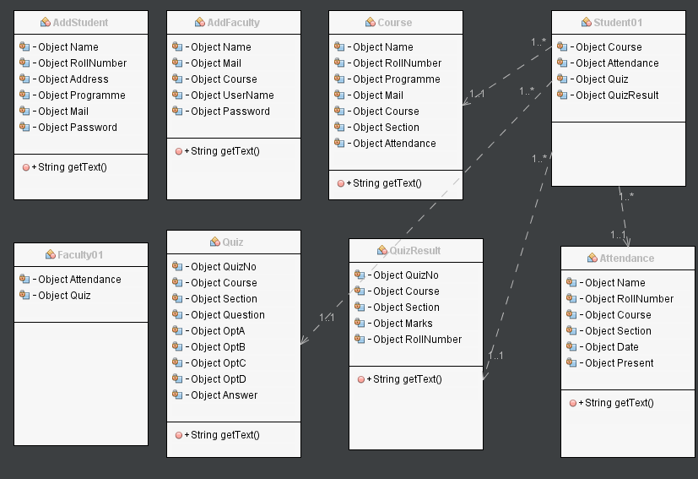
Class Diagram

Slide 7
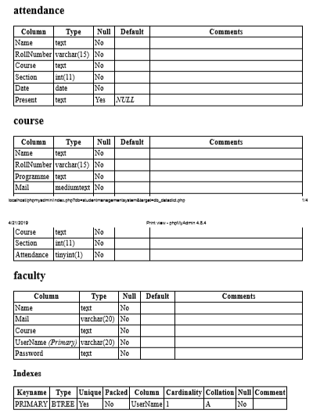
Data Dictionary

Slide 8
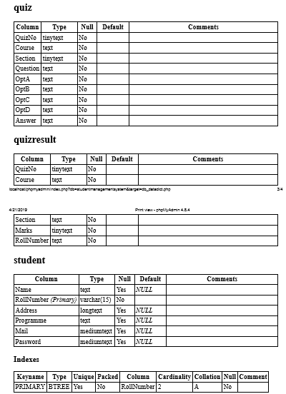
Data Dictionary

Slide 9
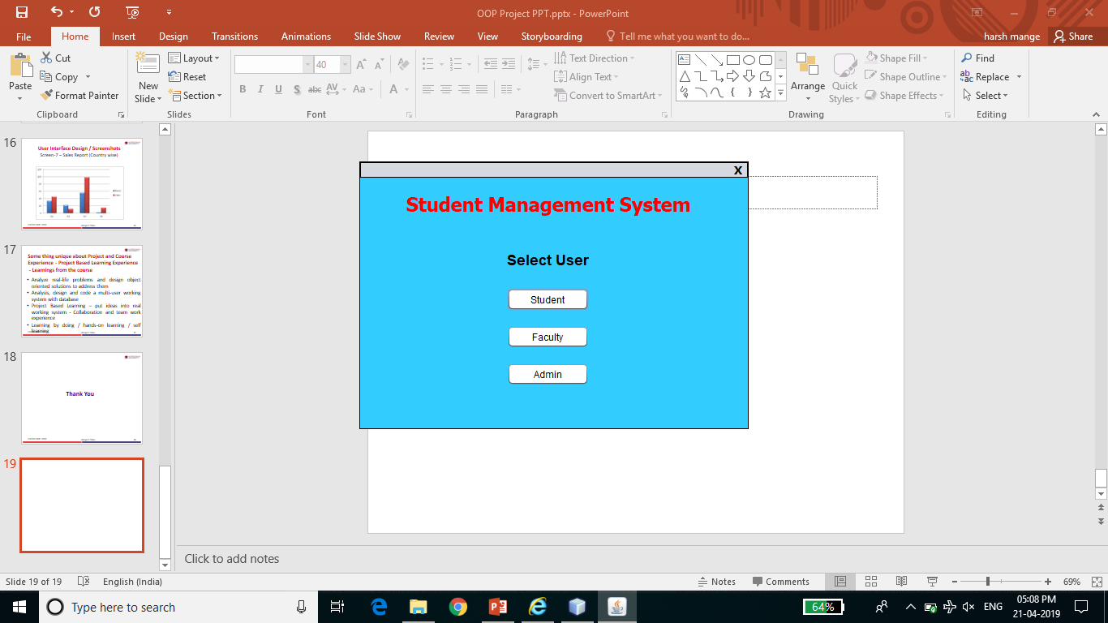
User Interface Design / Screenshots
Screen-1 - User Select screen

Slide 10
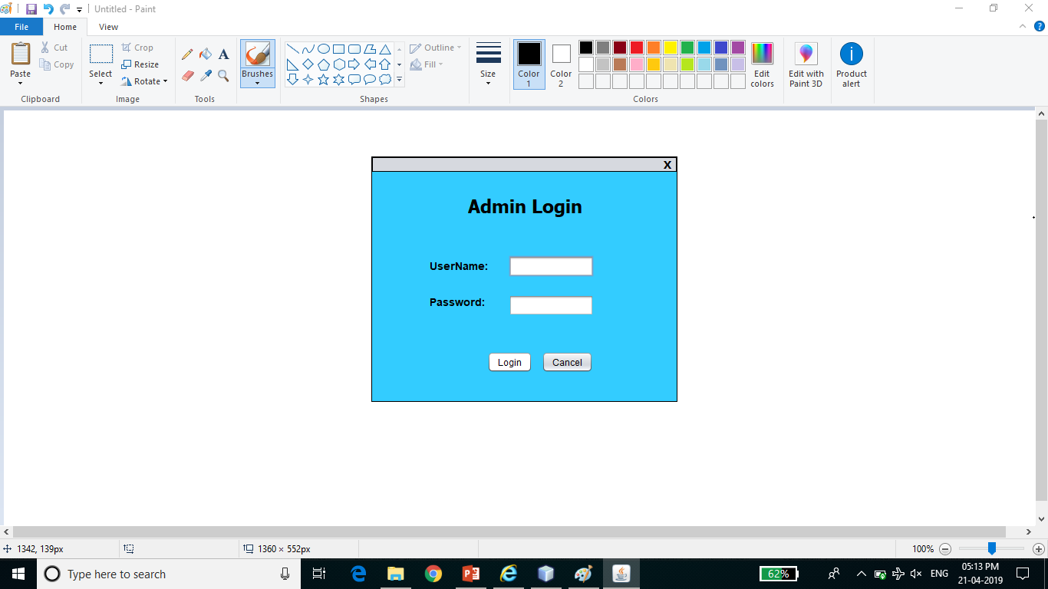
Screenshots
Screen-2 – Admin Login

Slide 11
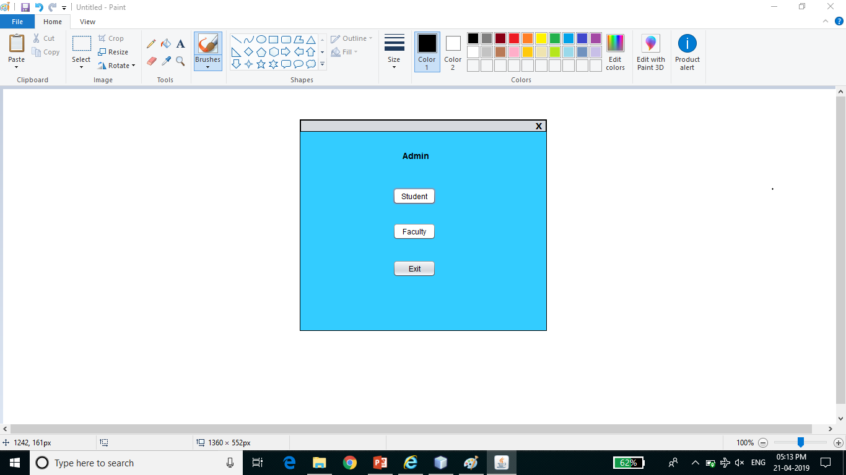
Screenshots

Slide 12
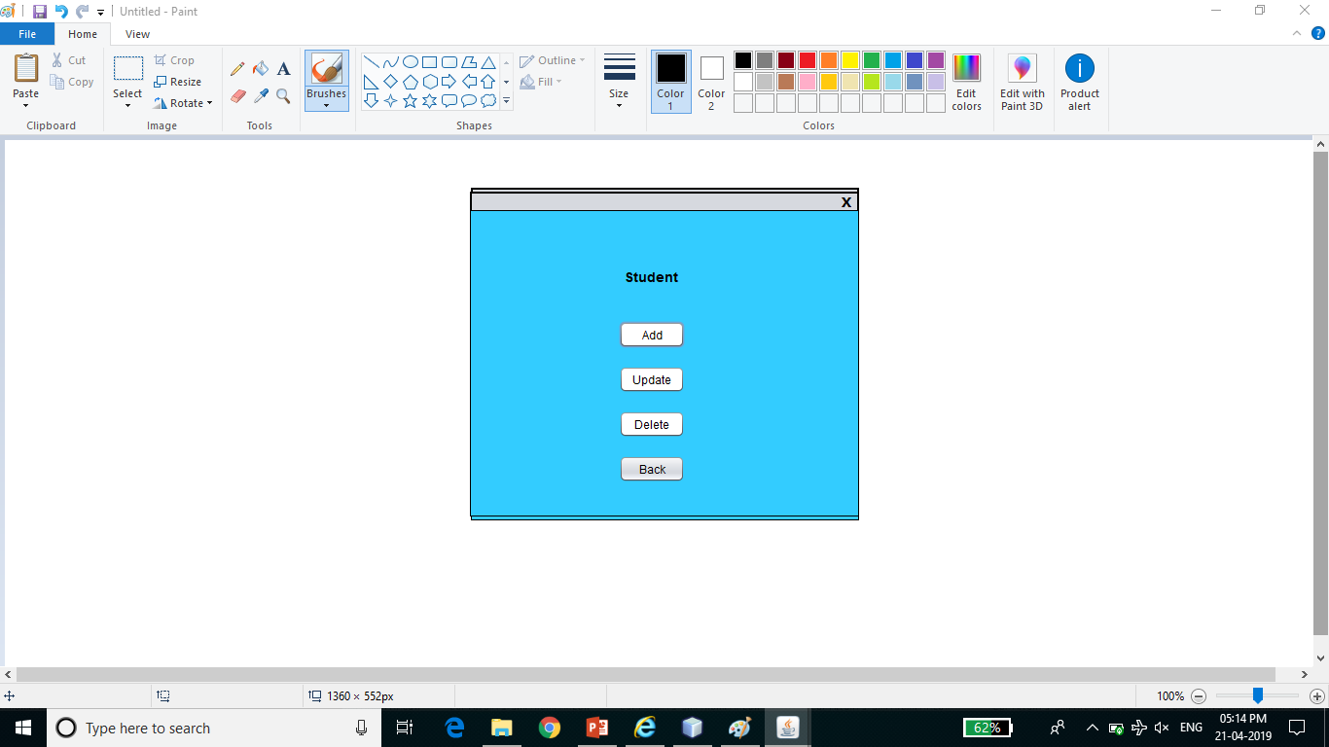
Screenshots

Slide 13
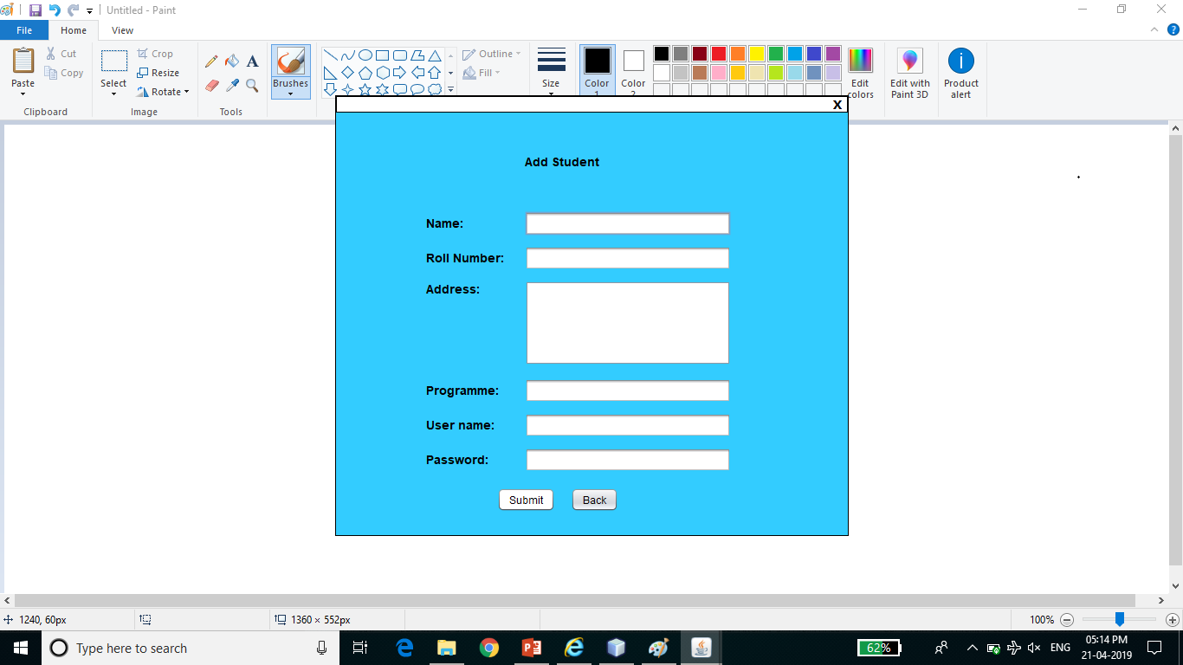
Screenshots

Slide 14
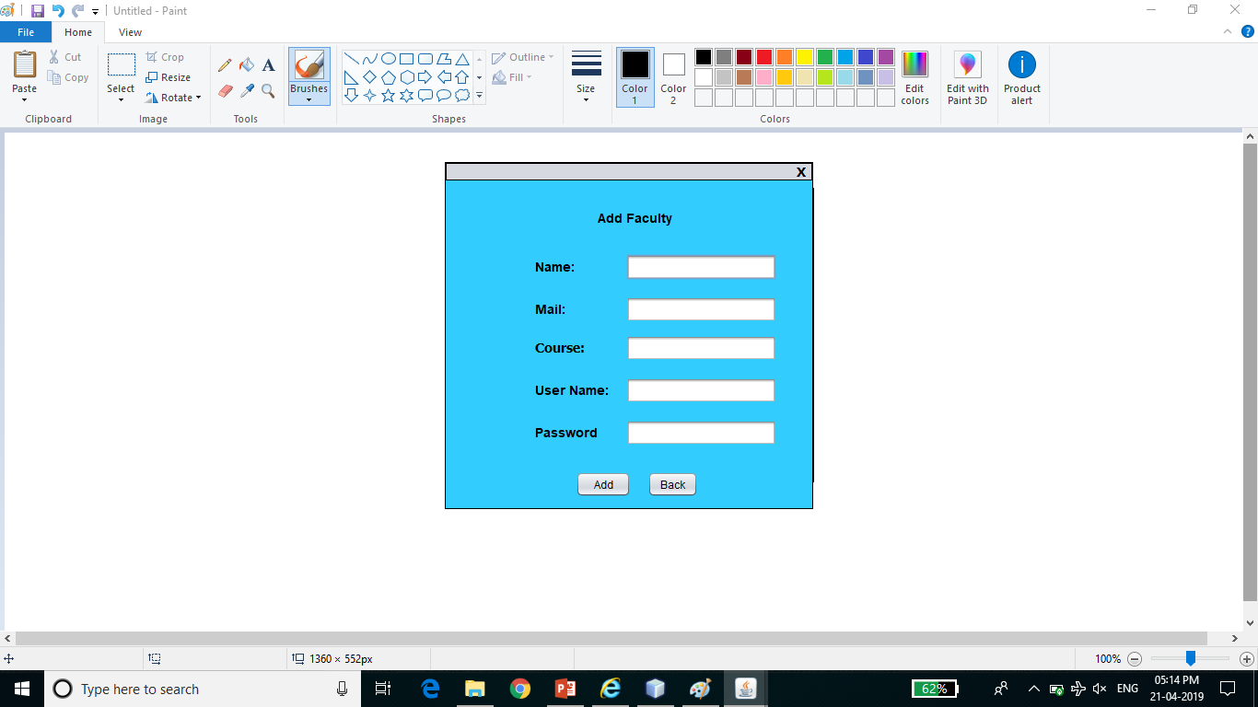
Screenshots

Slide 15
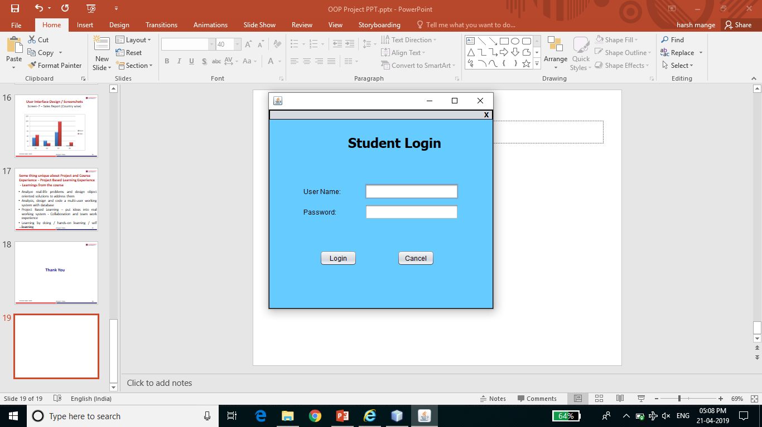
Screenshots

Slide 16
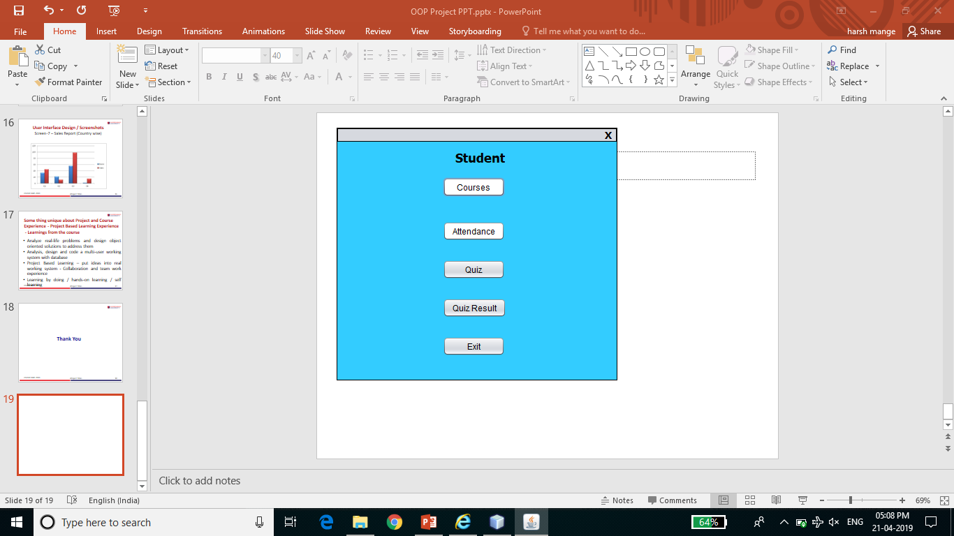
Screenshots

Slide 17
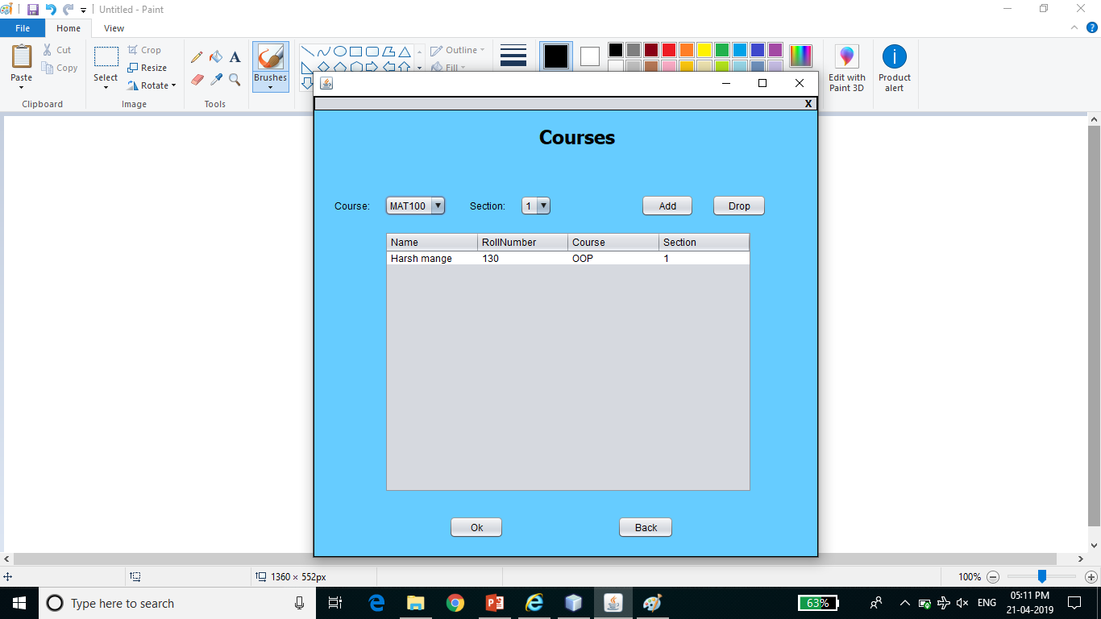
Screenshots

Slide 18
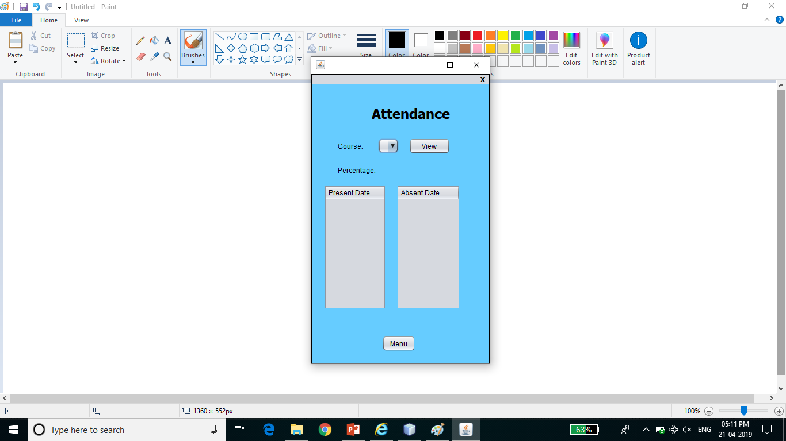
Screenshots

Slide 19
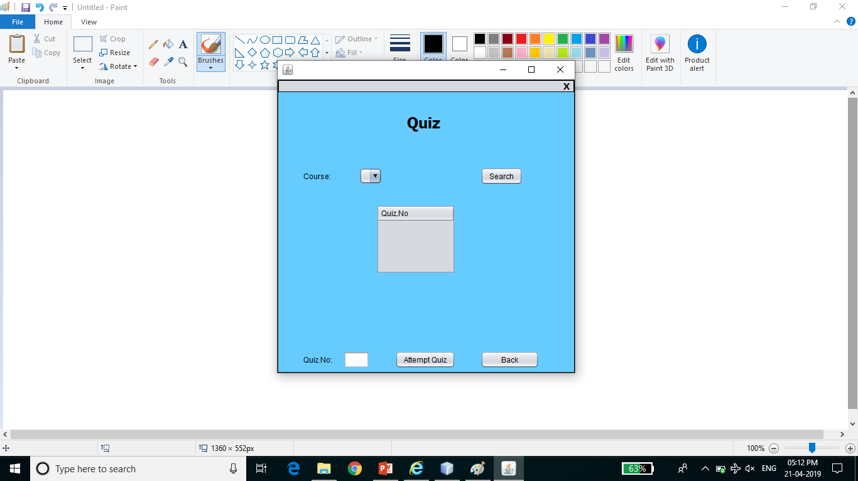
Screenshots

Slide 20
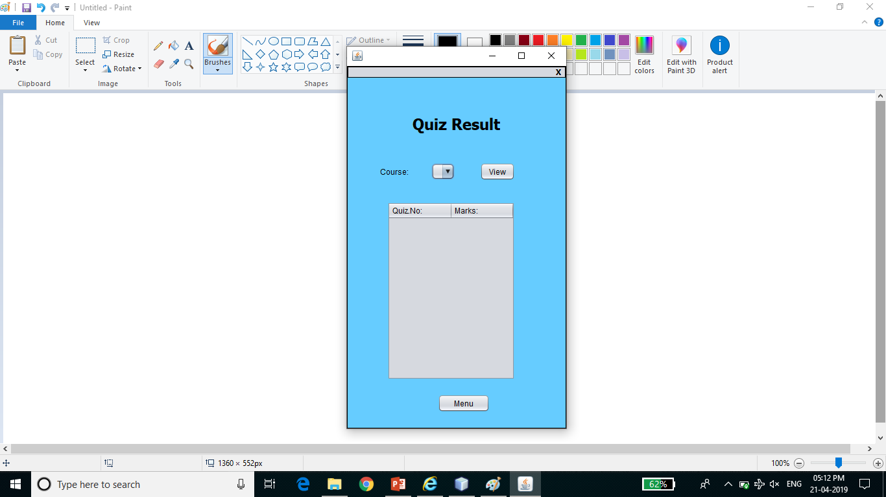
Screenshots

Slide 21
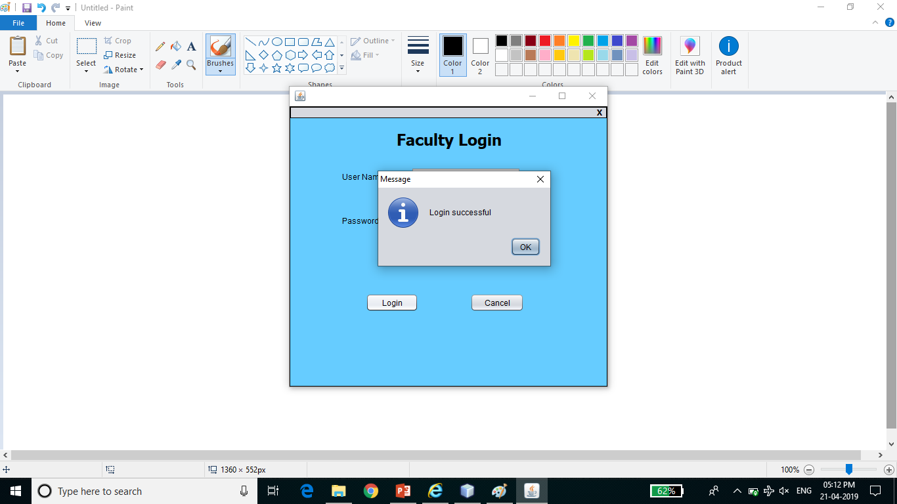
Screenshots

Slide 22
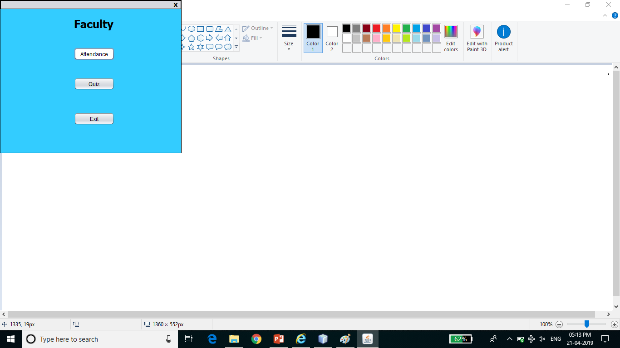
Screenshots

Slide 23
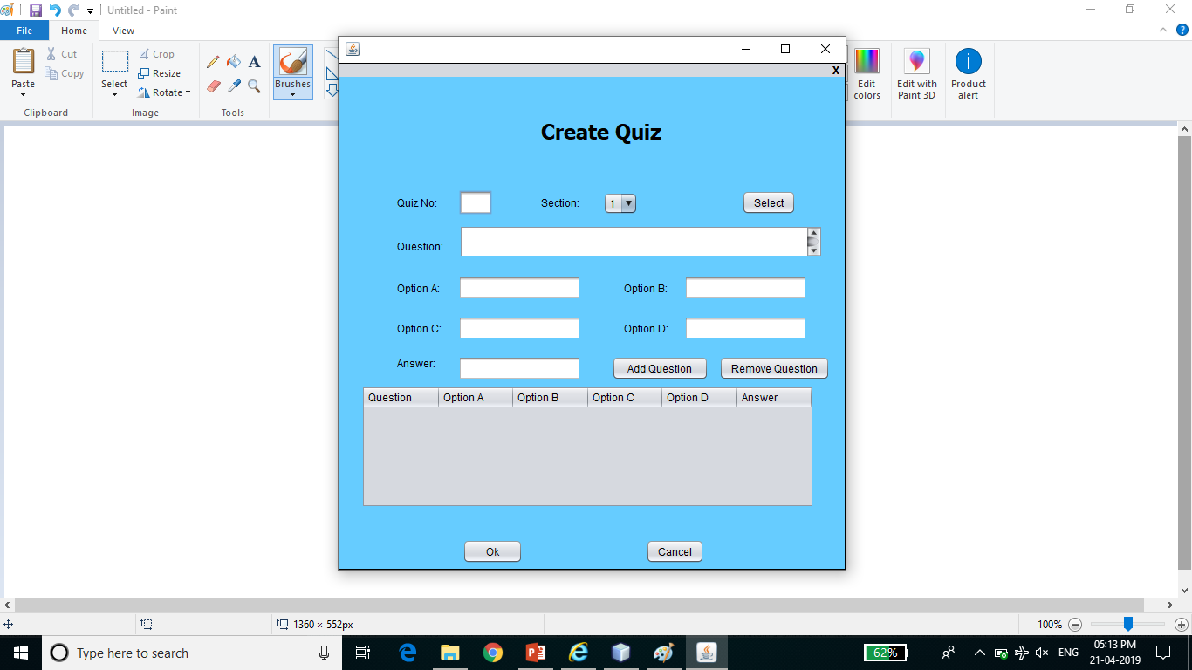
Screenshots

Slide 24
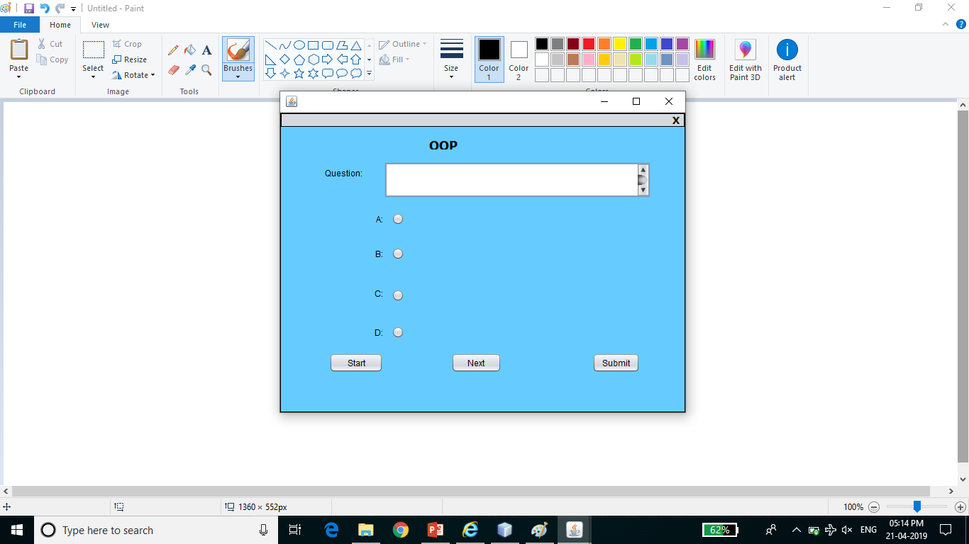
Screenshots

Slide 25
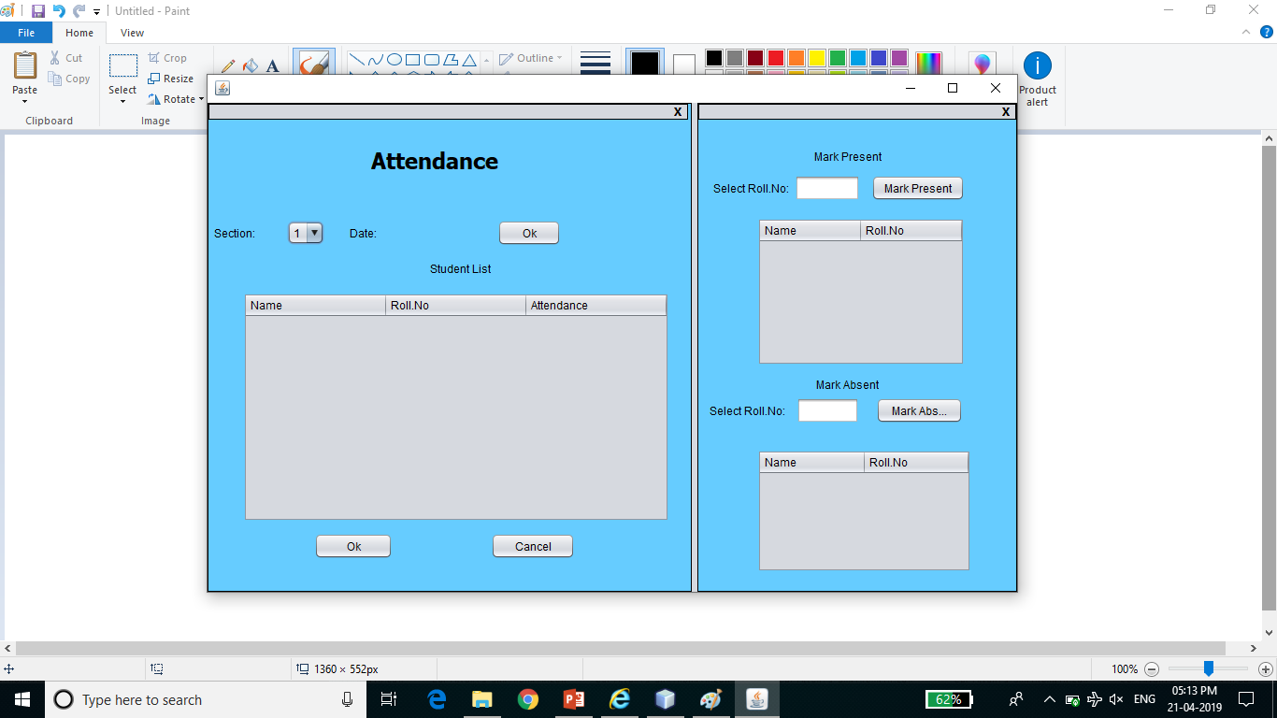
Screenshots

Slide 26
THANK YOU

